Slide 1
IDIG4004: Computer Vision and Applications Spring 2024
Part 7: Explainable AI (XAI)

Slide 2
Outline
Definitions, why explainability?
Inherently interpretable models
XAI techniques: Saliency maps, SHAP, LIME, concept bottleneck
Adversarial attacks

Slide 3

Some definitions
The interpretability of a model refers to the extent to which a human can understand the cause of a decision made by it. Interpretability is a property of the model that does not necessarily require additional tools or methods to explain it.
Explainability refers to the process of providing understandable explanations for the decisions made by a model, with the aid of post-hoc techniques if necessary.

Slide 4

Why do we need interpretability and explainability?
AI models can be opaque (the «black-box» effect), with unproven value to the end-users. This poses problems of trust, confidence and reliability.
Humans are curious! Especially if a prediction contradicts our «mental model».
Explanations can foster trust and acceptance.
If a model fails, gaining insight as to why is critical and may help adjusting the model design or the training strategy. This is particularly important in safety-critical applications (medical, financial,…) where one must be able to audit and debug.
AI model results are not definitive. Treating them as such can be risky, especially if they are being applied to new cases or contexts (transferability).
Causality analysis: explainability can shed light on which variables contribute the most to the model output.
Fairness, privacy.
Example of saliency-based explanations for COVID detection models. Model A provides a higher accuracy than model B, but it focusses on the wrong things!
Model A
Model B

Slide 5
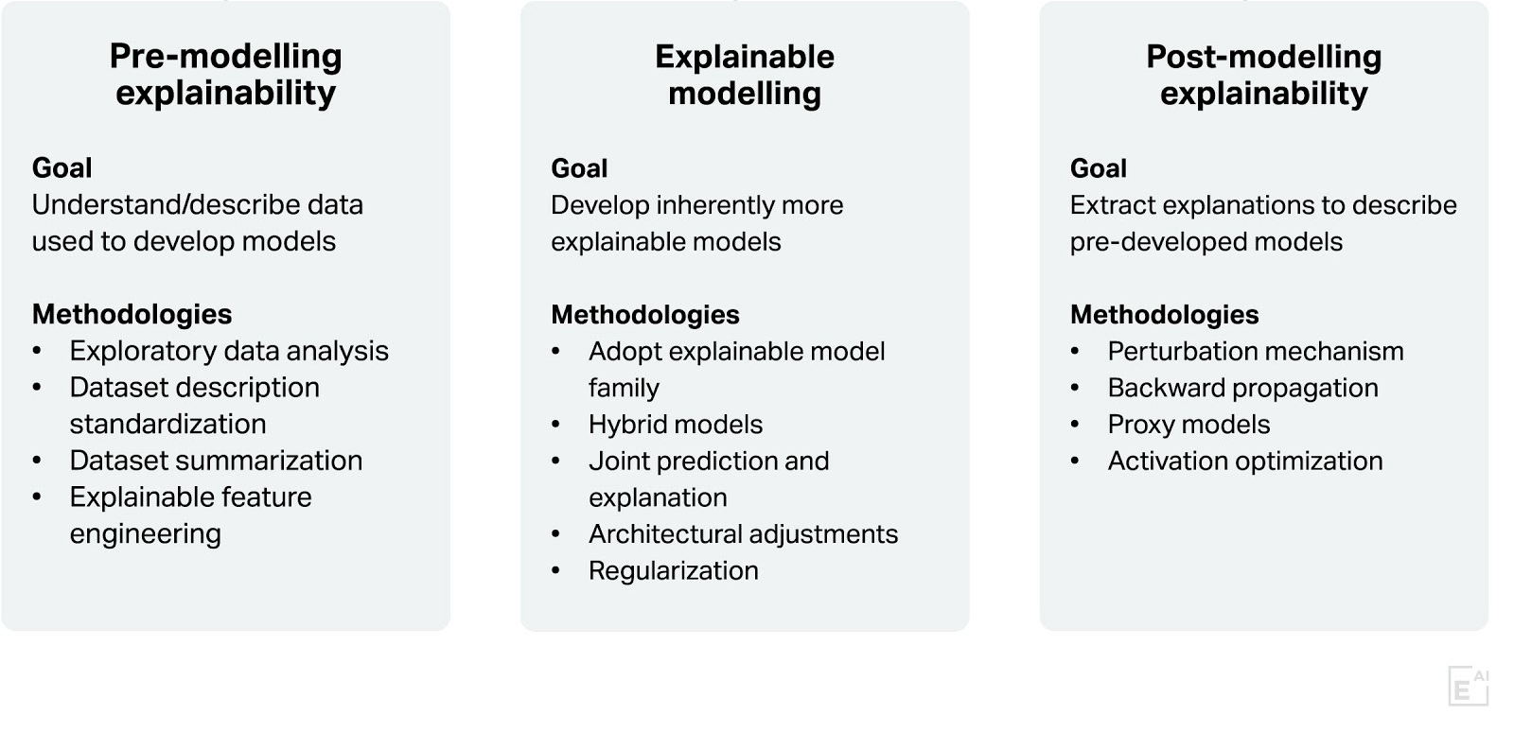
Stages of AI explainability

Slide 6
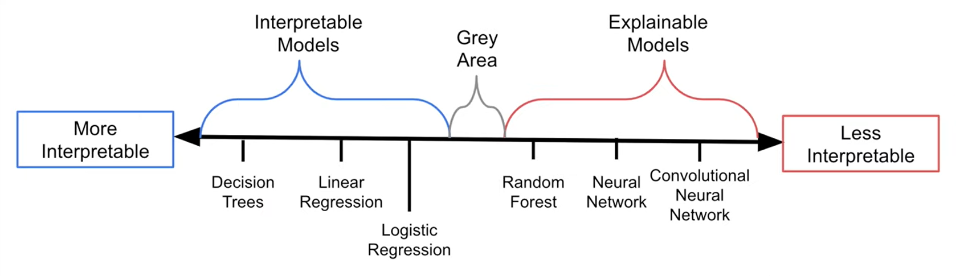
The «interpretability spectrum»

Slide 7
Inherently interpretable models: Linear regression
Consider this simple model that predicts the maximum loan that a person can obtain, based on age and salary: Y = 1000*age + 20*salary + 5000
A 30 year old earning 30,000 NOK a month can get a maximum loan of
??

Slide 8
Inherently interpretable models: Linear regression
Consider this simple model that predicts the maximum loan that a person can obtain, based on age and salary: Y = 1000*age + 20*salary + 5000
A 30 year old earning 30,000 NOK a month can get a maximum loan of 1000*30+20*30000 +5000 = 635000 NOK
The model can be interpreted via statements such as «For every additional year, one can get an additional 1000 NOK».

Slide 9
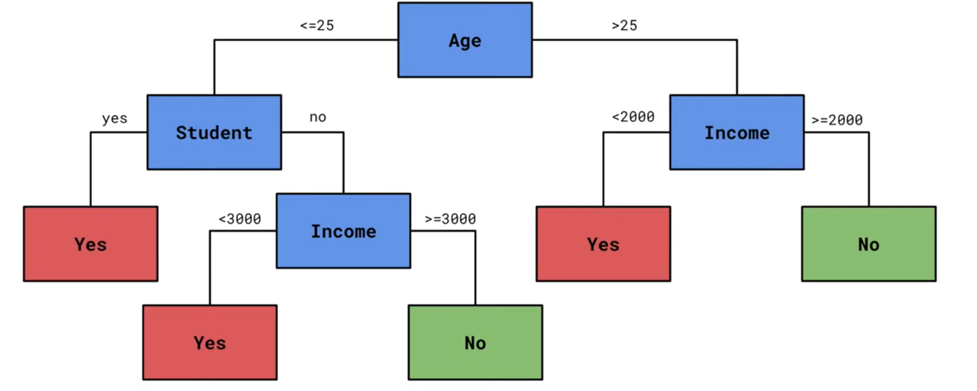
Inherently interpretable models: Decision tree
Here, we can interpret the model’s decision by following the branches of the tree.

Slide 10
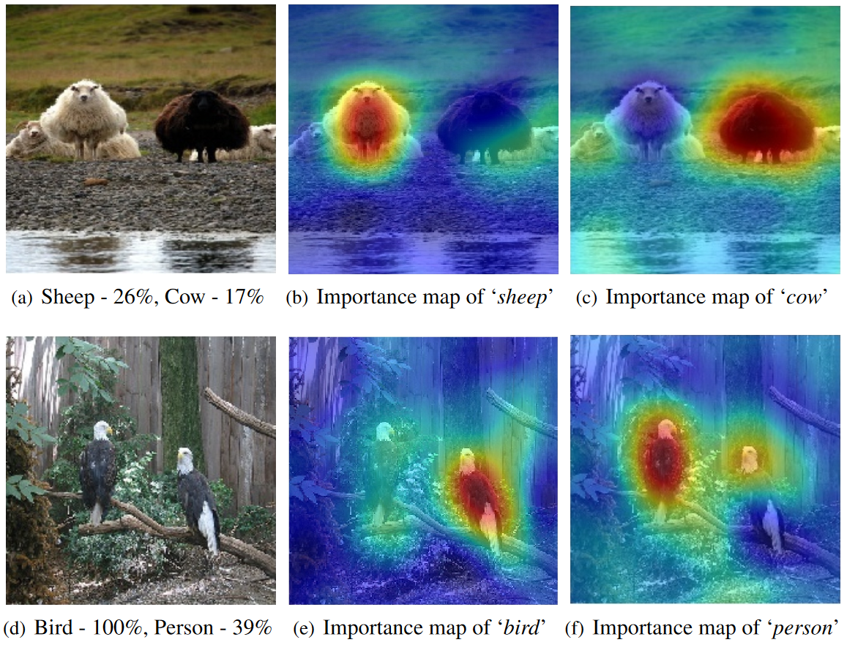
Saliency maps
Saliency maps capture image regions contributing the most to the model’s output.
The most straightfoward approach to produce such a map is to calculate the gradient of the model’s output with respect to each pixel in the input image.
In Python and Matlab, there are libraries to perform «automatic differentiation», which will calculate this gradient for you (provided that your model is differentiable).
Example of gradient-based methods include GradCAM (Gradient-weighted Class Activation Mapping) and RISE (Randomized Input Sampling for Explanation of Black-box Models).

Slide 11
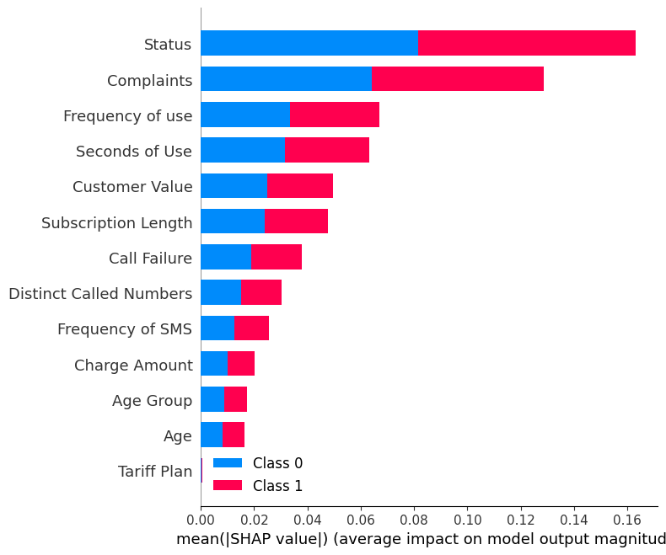
SHAP
SHAP (SHapley Additive exPlanations) values are a tool used to interpret the predictions of machine learning models. They help explain the output of any model by measuring the impact of each feature on the prediction.
SHAP values are grounded in game theory, particularly the concept of Shapley values, which allocate payouts to players based on their contribution to the total game winnings.
How They Work: For a given prediction, SHAP values quantify how much each input feature contributes, positively or negatively, towards the final output compared to the average prediction for the dataset. It makes a prediction using the model both including and excluding the feature of interest to understand how the presence or absence of a feature affects the prediction. the difference in prediction with the feature present and the prediction with the feature absent for each subset represents the marginal contribution of the feature to the prediction. Since there are many possible subsets, and a feature's contribution might vary depending on what other features are present, the SHAP value is calculated as the weighted average of these marginal contributions across all subsets.
Is the customer likely to cancel or not?
Example of SHAP values for a model predicting whether a customer is likely to cancel their phone subscription. It shows that «status» and «complaints» are mostly used by the model to make its decision

Slide 12
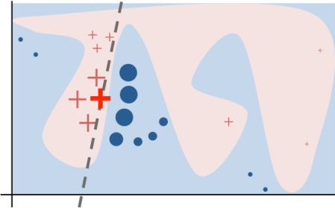
LIME
LIME (Local Interpretable Model-agnostic Explanations) explains a prediction by approximating the complex model locally with a simpler, interpretable model around the specific instance being explained.
How it works:
LIME starts by creating a new dataset consisting of perturbed samples (variations) of the instance and obtaining predictions for these samples from the complex model. Each perturbed sample is then weighted based on its similarity to the original instance—the closer it is, the more weight it carries in the explanation.
LIME then trains a simple model (like a linear regression or decision tree) on this new weighted dataset. This model is designed to be easy to understand and interpret.
The simple model’s coefficients (for linear regression) or rules (for decision trees) serve as the explanation, indicating which features of the instance are most important for the prediction.
Illustration of how LIME works: a complex inter-class boundary locally is approximated by a straight line.

Slide 13
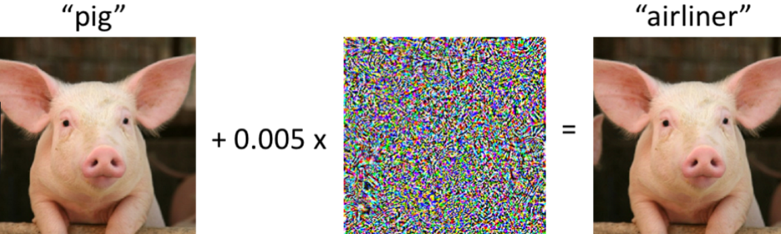
Adversarial attacks
Adversarial attacks involve subtly modifying input data (like images) to fool machine learning models into making incorrect predictions. These modifications are often imperceptible to humans but can lead to dramatically different model outputs.

Slide 14
Adversarial attacks
Adversarial attacks play a significant role in explainable AI by helping to:
Improve Model Robustness: Identify and address vulnerabilities in AI models, leading to the development of systems that are both more accurate and reliable.
Highlight Feature Importance: Uncover which features models prioritise for their decisions, which can reveal misalignments between model reasoning and human intuition.
Facilitate Error Analysis: Offer insights into conditions under which models might fail, crucial for enhancing reliability in critical applications.
Enhance Training Through Data Augmentation: Use adversarial examples as additional training data to teach models to correctly classify perturbed inputs.

Slide 15
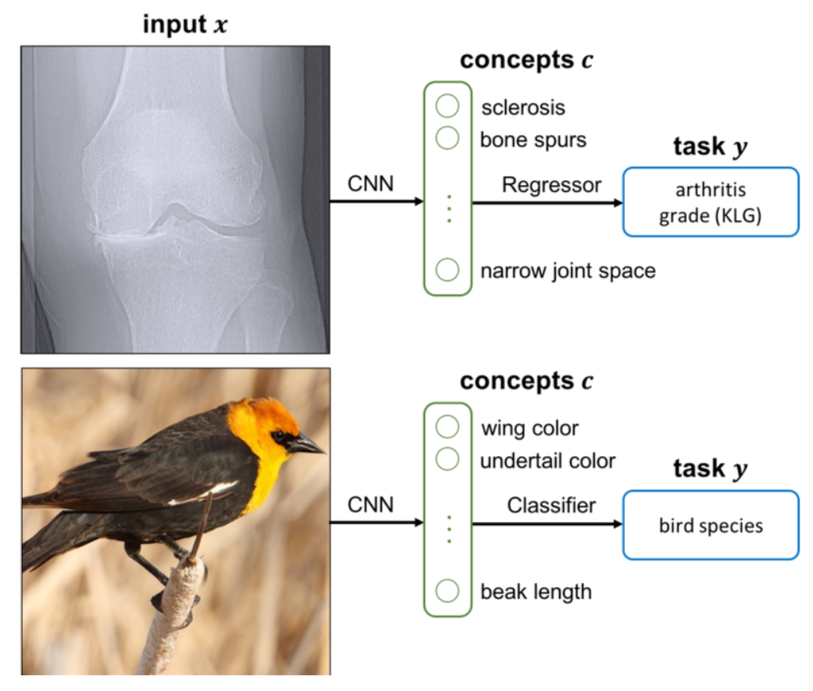
Concept bottleneck models
Concept bottleneck models “force” the model to learn meaningful concepts that contribute to the final decision. For example, bird species classification based on wing colour, beak length, etc.
They enable interpretation in terms of high-level concepts and allow for richer human-model interaction: accuracy improves significantly if we can correct model mistakes on concepts at test time.
Koh, Pang Wei, et al. "Concept bottleneck models." International conference on machine learning. PMLR, 2020.

Slide 16
Summary
Definitions, why explainability?
Inherently interpretable models
XAI techniques: Saliency maps, SHAP, LIME, concept bottleneck
Adversarial attacks

